Slide 1
DATA ANALYTICS • SQL • BUSINESS INSIGHTS
Zomato Restaurant
Data Analysis
From relational data to actionable business insights
TEAM • SELECT STAR ⭐
Yukta Jaysingpure
Monika Mengawade
Akash Jadhao
Revan Gunjal
PROJECT PRESENTATION

Slide 2
ZOMATO DATA ANALYSIS
Project overview
Business objective, scope and analytical workflow
THE OBJECTIVE
WHAT THE DATA COVERS
EXPECTED OUTPUT
Analyze the Zomato restaurant database with SQL to uncover business insights and support data-driven decisions.
Restaurants • Customers • Menu items
Orders • Payments & delivery details
Ratings & customer feedback
Validated SQL results, a Power BI dashboard, business insights and practical recommendations.
PROJECT WORKFLOW
01
02
03
04
05
Dataset
›
SQL database
›
SQL queries
›
Insights
›
Actions
02 / 14

Slide 3
ZOMATO DATA ANALYSIS
Methodology
A structured process from question definition to recommendations
01
Understand the problem
02
Study the schema
03
Write SQL queries
Define business questions and objectives.
Explore tables, keys and relationships.
Build and test analytical queries.
04
Execute & validate
05
Generate insights
Verify outputs against expected results.
Interpret results and recommend actions.
03 / 14

Slide 4
ZOMATO DATA ANALYSIS
Dataset overview
MySQL relational database • Source slide reports five key tables
TABLE INVENTORY
Table
Rows
Columns
Key / relationship
users
100,000
10
user_id
restaurant
148,541
12
restaurant ID
orders
150,281
6
user_id and r_id
menu
1,179,936
5
menu_id
food
371,561
3
f_id
Schema uses relational keys to connect users, restaurants, orders, menus and food records.
04 / 14

Slide 5
ZOMATO DATA ANALYSIS
Challenges & solutions
Data preparation and query design considerations
DATA TYPE MISMATCHES
NULL RATINGS
DUPLICATE ORDERS
Date and numeric fields stored as text required CAST() and CONVERT() for aggregation.
Missing ratings can skew averages; use IS NOT NULL filters and appropriate null handling.
ROW_NUMBER() with a CTE was used to identify duplicate records before final analysis.
JOIN COMPLEXITY
VALIDATION
Use clear aliases and LEFT JOIN logic where needed to preserve restaurant records.
Compare query outputs with expected results before using them in reporting.
05 / 14

Slide 6
ZOMATO DATA ANALYSIS
Relational model
High-level view of the main table relationships
users
PK: user_id
user_id
orders
FK: user_id, r_id
r_id / id
restaurant
PK: id
menu links
menu
FK: r_id, f_id
f_id
food
PK: f_id
06 / 14

Slide 7
ZOMATO DATA ANALYSIS
SQL analysis
Five example analytical questions from the project
01
Top 10 restaurants by sales
SUM() • GROUP BY • ORDER BY DESC • LIMIT
02
Monthly order trends
DATE_FORMAT() • COUNT() • GROUP BY month
03
Menu pricing by cuisine
AVG() • GROUP BY cuisine • ORDER BY
04
Underperforming restaurants
COUNT() • LEFT JOIN • HAVING
05
Cuisine demand by city
JOIN • COUNT() • GROUP BY city and cuisine
07 / 14

Slide 8
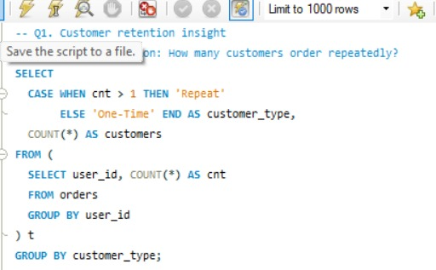
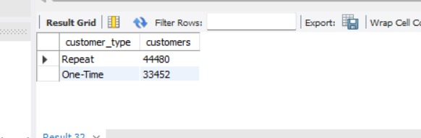
ZOMATO DATA ANALYSIS • ADDITIONAL INSIGHT
15 / 15
Customer Retention: Repeat vs One-Time
Business question: How many customers order repeatedly?
SQL QUERY
QUERY OUTPUT
BUSINESS INSIGHT
44,480 repeat customers vs 33,452 one-time customers. Use retention campaigns and targeted offers to encourage one-time customers to return.
Note: Results shown are from the provided MySQL screenshots; validate against final dataset before external reporting.

Slide 9
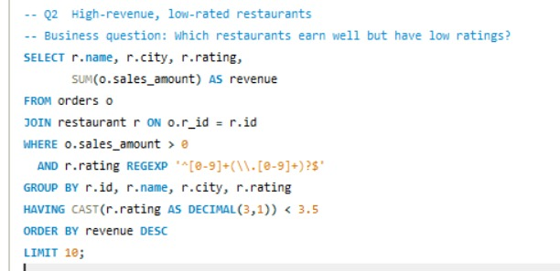
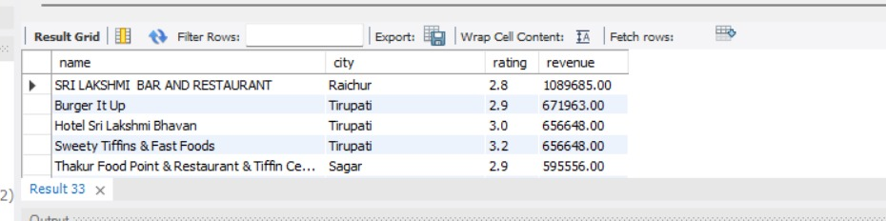
ZOMATO DATA ANALYSIS • ADDITIONAL INSIGHT
16 / 16
High-Revenue, Low-Rated Restaurants
Business question: Which restaurants earn well but have low ratings?
SQL QUERY
QUERY OUTPUT
BUSINESS INSIGHT
The result highlights restaurants with low ratings but substantial recorded revenue. Investigate customer feedback and service quality to protect customer satisfaction.
Note: Results shown are from the provided MySQL screenshots; validate against final dataset before external reporting.

Slide 10
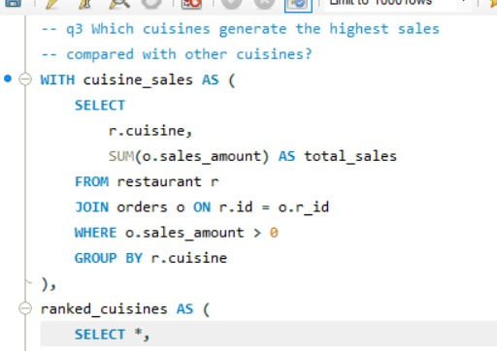
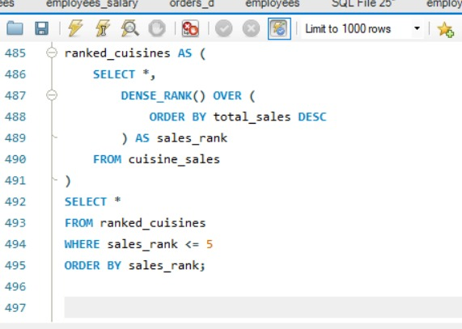
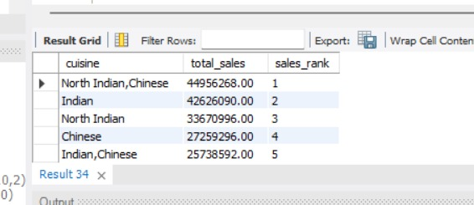
ZOMATO DATA ANALYSIS • ADDITIONAL INSIGHT
17 / 17
Top-Selling Cuisine Categories
Business question: Which cuisines generate the highest sales compared with other cuisines?
SQL QUERY
QUERY OUTPUT
BUSINESS INSIGHT
The output ranks 'North Indian,Chinese' first, followed by Indian and North Indian. Use cuisine-level results to guide marketing and partner discussions; comma-separated labels are treated as one category.
Note: Results shown are from the provided MySQL screenshots; validate against final dataset before external reporting.

Slide 11
ZOMATO DATA ANALYSIS
Business findings from the three additional SQL analyses
Key findings reported in the original project deck
CUSTOMER RETENTION
REPEAT-ORDER OPPORTUNITY
HIGH REVENUE, LOW RATINGS
44,480 repeat customers versus 33,452 one-time customers. Repeat customers are a valuable group to retain.
33,452 one-time customers represent an opportunity for targeted offers that encourage a second order.
Some restaurants generate substantial recorded revenue despite ratings below 3.5. These partners may need service-quality reviews.
TOP CUISINE SALES
BUSINESS PRIORITY
The highest-ranked cuisine label is “North Indian,Chinese”, followed by “Indian” and “North Indian”.
Protect customer retention, investigate low-rated high-revenue restaurants, and use cuisine sales rankings to guide marketing tests.
Insights are based on the SQL outputs shown on slides 8–10; validate figures against the final dataset before external reporting.
09 / 14

Slide 12
ZOMATO DATA ANALYSIS
Recommendations directly linked to the customer, rating and cuisine SQL results
Turn analysis into practical next steps
KEY INSIGHTS FROM SQL
RECOMMENDATIONS
• Customer retention: 44,480 repeat customers and 33,452 one-time customers.
• Restaurant quality: identify high-revenue restaurants rated below 3.5.
• Cuisine sales: “North Indian,Chinese” ranks first, followed by “Indian” and “North Indian”.
• Run targeted win-back offers to convert one-time customers into repeat customers.
• Review customer feedback, food consistency and service at high-revenue, low-rated restaurants.
• Use cuisine sales rankings to plan promotional tests and restaurant-partner campaigns.
• Track repeat-order share, ratings and cuisine sales after each action.
11 / 14

Slide 13
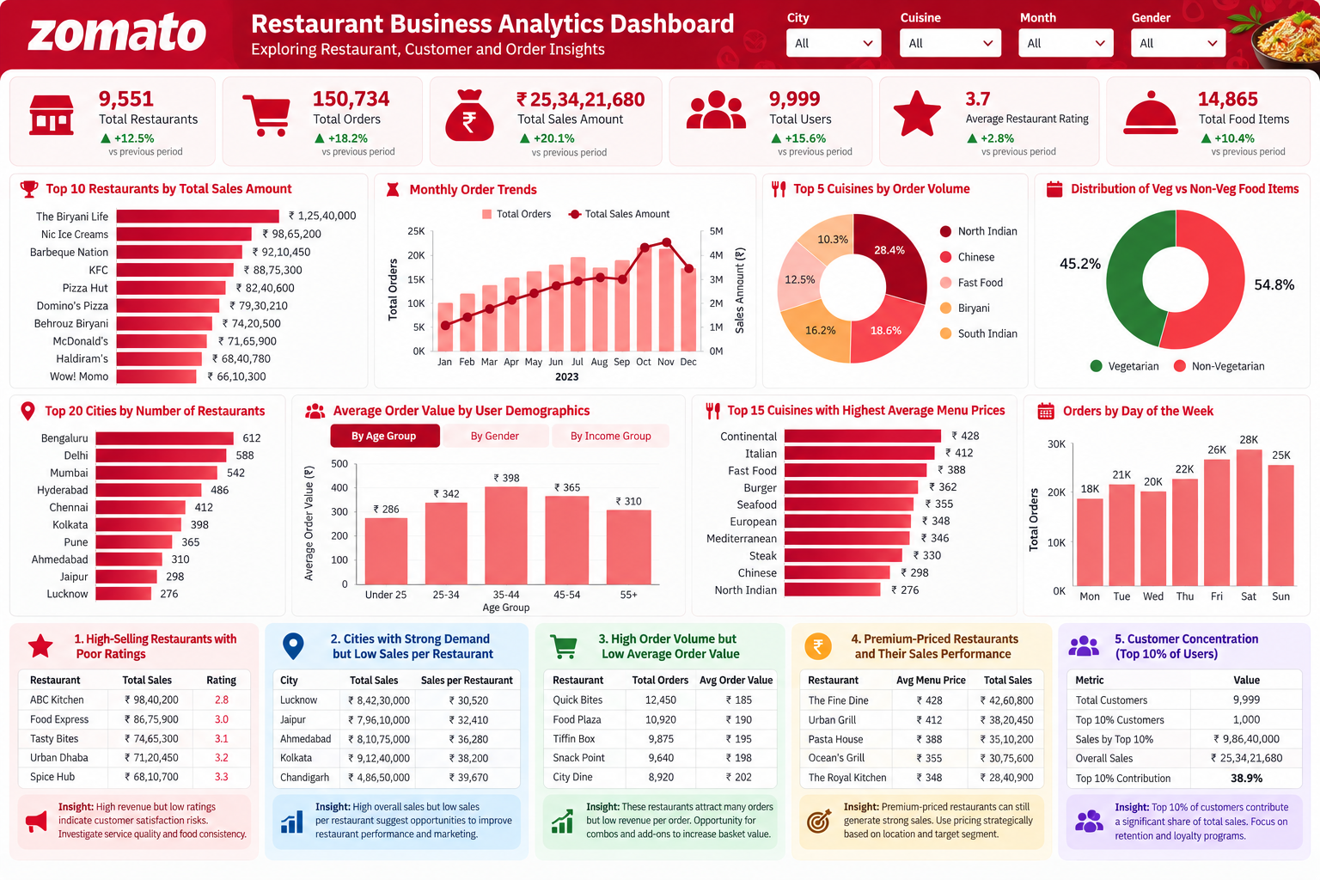
ZOMATO RESTAURANT BUSINESS ANALYTICS DASHBOARD
Interactive-style overview • SQL-derived metrics • Business insights
Source: uploaded project dashboard image • Validate displayed metrics against final SQL query outputs.

Slide 14
ZOMATO DATA ANALYSIS
Conclusion
End-to-end data analysis workflow
DATABASE
ANALYSIS
DECISIONS
Built a normalized MySQL database structure for restaurant-related analysis.
Used SQL to explore sales, restaurants, cuisines and customer trends.
Presented insights and recommendations through dashboard-style reporting.
From data tables → validated queries → visual reporting → business action
Thank you
Questions & discussion
13 / 14

Slide 15
SELECT STAR ⭐
Thank You
Zomato Restaurant Data Analysis
PROJECT TEAM
Yukta Jaysingpure
Monika Mengawade
Akash Jadhao
Revan Gunjal
QUESTIONS & DISCUSSION

